Slide 1



HACCLE: Metaprogramming for Secure Multi-Party Computation
Y Bao^{*+}, K Sundararajah*, R Malik, Q Ye, C Wagner, N Jaber,
F Wang, MH Ameri, D Lu, A Seto, B Delaware, R Samanta,
A Kate, C Garman, J Blocki, PD Letourneau, B Meister, J Springer,
T Rompf, and M Kulkarni
* Both authors contributed equally to this work.
⁺Work performed while author was at Purdue University.
Notes:
Hello Everyone, I am Kirshanthan Sundararajah from Purdue University.
Today I am going to talk about our work HACCLE: Metaprogramming for Secure Multi-Party Computation.
This work is done in collaboration with many people from Purdue University and Reservoir Labs.
My coauthor Yuyan equally contributed to this work as myself and this was done while she was at Purdue University.

Slide 2
Secure Multi-Party Computation
“A group of distrusting parties jointly perform computation
without revealing any participant’s private data”
Notes:
Now let us look at Secure Multi-Party Computation.
Secure Multi-Party Computation is a collection of cryptographic techniques that enables multiple distrusting parties to jointly perform computation without revealing any participant private data – data they don’t wish to make public.
Generally abbreviated as Secure MPC.
There are many practical applications such as secure online auctions, privacy-preserving machine learning where model and data are owned by different parties, privacy preserving genomics, spam filtering on encrypted emails etc.

Slide 3
Secure Multi-Party Computation
Secret Sharing
Garbled
Circuits
Homomorphic
Encryption
Protocols
Communication Models
Trust Models
Notes:
There are many different Secure MPC protocols, and they are based on cryptographic techniques such as Secret Sharing, Homomorphic Encryption and Garbled Circuits.
Each protocol requires the parties to obey a specific communication model.
For example, client-server model where there are only two parties etc.
Different application setting and protocol together may have different trust models of the parties.
For instance, a semi-honest trust model is where no party can deviate from the protocol when performing the computation, but some parties may try to actively learn details about other parties.
So, you can see that secure MPC application setup is inherently complicated and now let us see a motivating example to understand why it is challenging.

Slide 4
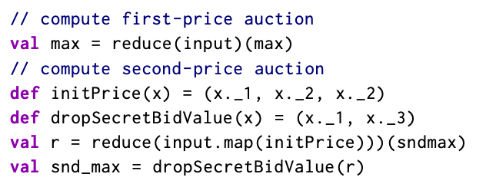
Motivating Example: Secure Auction
Winner
Pays Highest
Price
Winner
Pays 2nd Highest
Price
Bid 1
Bid 5
P1
Contract
Terms
Contract
Terms
P5
Bid 2
G1
G2
Bid 6
P2
P6
Bid 3
G0
Bid 7
P3
Contract
Terms
Contract
Terms
P7
Bid 4
G3
G4
Bid 8
P4
P8
First-Price Auction
Second-Price Auction
Generalized Auction
Notes:
Let us consider an example of auction where parties don’t trust each other, even the auctioneer. Example public procurement for building contract
--
All parties place their seal bids.
The winner is the party who offers the highest price for the item and it is sold for the winner for that highest price.
This is called a first price auction and it requires a few comparisons.
--
But in order to avoid price discovery the winner is offered to buy the item for the second highest price.
This is known as second price auction and the computation are different.
--
Now think of the scenario where there are multiple items and contract terms that considered when comparing bids for that item.
This is a generalized auction

Slide 5
Motivating Example: Secure Auction
Winner
Pays Highest
Price
Winner
Pays 2nd Highest
Price
Bid 1
Bid 5
P1
Contract
Terms
Contract
Terms
P5
Bid 2
G1
G2
Bid 6
P2
P6
Bid 3
G0
Bid 7
P3
Contract
Terms
Contract
Terms
P7
Bid 4
G3
G4
Bid 8
P4
P8
First-Price Auction
Second-Price Auction
Generalized Auction
Notes:
It would become cumbersome to write each auction separately

Slide 6
Motivating Example: Secure Auction
Winner
Pays Highest
Price
Winner
Pays 2nd Highest
Price
Bid 1
Bid 5
P1
Contract
Terms
Contract
Terms
P5
Bid 2
G1
G2
Bid 6
P2
P6
Bid 3
G0
Bid 7
P3
Contract
Terms
Contract
Terms
P7
Bid 4
G3
G4
Bid 8
P4
P8
First-Price Auction
Specialization
Second-Price Auction
Generalized Auction
Notes:
Secure MPC applications are already difficult to implement.
--
If we have an approach that would automatically specialize a generalized auction to second-price auction, or to first-price auction based on the scenario then,
that will make the development of Secure MPC applications much smoother.

Slide 7
Need for a Compilation Framework
MPC is Slow!!
Computation
Computations are acyclic circuits!
Protocol 1
Protocol 2
Protocol 3
Higher Level
Abstractions
(e.g., PL)
Low Level
Primitives
(e.g., +, *)
Cryptographic
Expert
Circuit Optimization
Expert
Backend 1
Backend 2
Inspired from
HW Design
(E.g., Spatial, Chisel)
Key Approach
Metaprogramming
Circuit-like
Abstraction
Notes:
But why do we need a compilation framework to solve this problem?
--
First, Secure MPC applications are extremely slow because of the nature of cryptographic primitives.
Even switching from one backend to another backend which uses the same protocol requires an enormous effort since the abstractions provided by backends vary.
Some provide primitive abstractions such as arithmetic operations and some provides their own high-level abstraction to express your computation.
--
Migrating your computation from one protocol to another requires some level of cryptographic expertise.
--
Since Secure MPC applications are inherently slow, performing optimization to improve performance is critical to get an acceptable run time for your applications.
In almost all the Secure MPC protocols, computations are abstracted as acyclic circuits.
Hence optimizing this circuits requires some level of circuit optimization expertise.
--
Inspired from work in HW design such as spatial and chisel, our key approach to solve these challenges is lowering code describing Secure MPC application to a circuit like abstraction and performing optimizations using meta programming techniques.
For example, reduction can be realized as a tree reduction to allow more parallel computation.
For the rest of the talk, I will discuss about this novel and compelling approach to realize secure MPC applications.

Slide 8
Contributions
HACCLE Toolchain
A compilation framework to build and execute MPC applications written in Harpoon – an eDSL in Scala based on Lightweight Modular Staging (LMS).
HACCLE Intermediate Representation (HIR)
An extensible Circuit-like IR tailored to abstract crypto primitives used in MPC.
Optimization Strategies
Notes:
Main contributions of our work are,
-HACCLE toolchain, a compilation framework to build and execute secure MPC applications written in Harpoon, an embedded DSL in Scala based on Lightweight Modular Staging to realize our abstractions
-HACCLE Intermediate Representation (HIR) An extensible Circuit-like IR to abstract crypto primitives used in MPC
-And some optimization strategies to make the secure MPC applications performant.

Slide 9
HACCLE Workflow
Stage 1: Extract the Secure Computation
Stage 2: Generating the Abstract Circuit
Stage 3: Protocol Specific HIR Operations
Stage 4: Backend Specific Operations
Notes:
Now let us look at the the workflow of HACCLE framework.
The diagram shows all the different stages of compilation.
The first stage takes a program written Harpoon embedded in Scala and it extracts the Harpoon part, which is the secure computation.
After this stage, the communication channels would have been already set and the data will be ready to properly flow.
Stage two takes in harpoon program and translate it to a HIR program which is the circuit like description of the computation.
At this stage harpoon type system prevents errors like assigning a ciphertext to a plaintext.
Stage three takes in a protocol independent HIR program and specialize it into a protocol specific one.
Type system in this stage prevents protocol specific errors. For instance, prevent a non player accessing shared a piece of data.
Stage four takes in a protocol specific HIR and produces code for a specific backend.
We count resource estimation as a separate backend.
This backend can estimate the cost of the computation in a particular protocol based on a cost model.

Slide 10
HAccle Rich Representation for Program OperatiON (Harpoon)
Subset of Scala
Imperative and monomorphic language
function calls, conditionals, loops and recursion.
Provides Cryptographic Data Structures
E.g., Encrypted Array
Annotation (@sec) to mark the owner of private data
Notes:
- Now let us take look at the harpoon language which is used to express the main secure MPC computation.
- Harpoon is a subset of Scala.
- It’s an imperative monomorphic language and it has the usual control flow structures such as function calls, conditionals, loops and recursion.
- Later we will see that when we lower them
functions get inlined
loops and recursion get unrolled
conditionals get lowered to selection logic (akin to a mux in HW).
Harpoon also provided cryptographic data structures such as encrypted arrays
encrypted arrays are further lowered down the pipeline to a suitable selection logic to maintain data obliviousness
Harpoon provides annotation to the ownership of a piece of data
this helps down the pipeline to type check and find any violation specific to certain protocols

Slide 11
HACCLE Intermediate Representation
Multi-level IR
Type system
Obliviousness
Encrypted Array Indexing
Conditional Execution
Loops and Recursion
Float, FloatArray
UNum, UNumArray
Num, NumArray
Bit, BitArray
def +(x: ShareNum, y: ShareNum) = {
assert(x.players.equals(y.players))
assert(x.threshod == y.threshold)
…
}
def +(x: ShareNum, y: ShareNum) = {
assert(x.players.equals(y.players))
assert(x.players.size == x.threshold)
assert(x.threshod == y.threshold)
…
}
refined
Notes:
Harpoon is lowered to HACCLE Intermediate Representation, HIR.
HIR is protocol independent and it’s a multi-level IR in which we can perform rewrites without leaving the IR.
Not every backend provide operations on all the datatypes.
For example, a backend may provide only bitwise operations.
In that case a program written to operate on integers must be automatically rewritten to operate only on bits and bit arrays.
For instance, addition of integers may be rewritten using full adders.
HIR is typed, and it gets refined when it is lowered to a protocol-specific HIR. This helps to catch errors that are specific to a protocol.
Type rules provide an approximation of data access policy that specifies how data is provided, accessed, and shared.
For example, code shown here shows the assertions in addition operation for the type of shared number.
This get refined with more checks when it is lowered secret sharing protocol specific HIR.
If an HIR instruction is lowered to a particular protocol in which there are no equivalent operations, that manifests as a type error.
A program without privacy concern diverts its control flow according to the input: statements are executed conditionally, loop for a variable number of iterations, etc.
To protect privacy, Boolean and arithmetic circuits must be oblivious in the sense that they perform the same sequence of operations regardless of the input.
This requires
Indexing an array with a ciphertext is encoded as a multiplexer circuit
If the condition of the if then statement depends on ciphertext then it is transformed to a selector logic
All function calls are inlined; All loops are unfolded as the number of iterations is a compile-time constant.
For recursive functions, obliviousness is achieved by using the extra plaintext that gives a bound of recursion
This makes sure that the recursive call only iterates times specified by the bound.

Slide 12
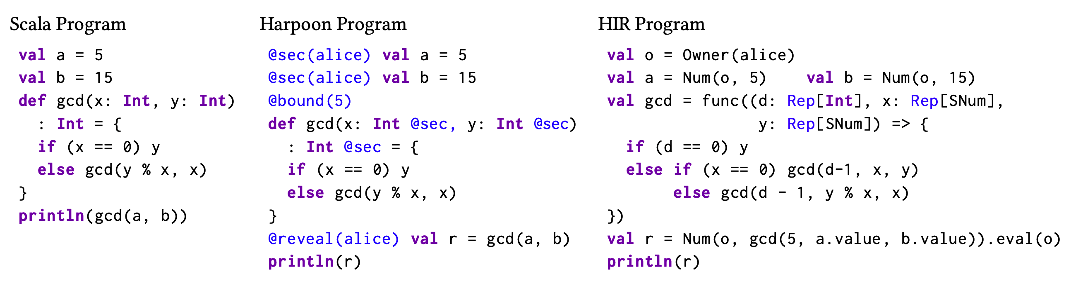
Harpoon and HIR Example
Notes:
Now let us look at an example of Harpoon and equivalent HIR programs.
On the left we can see a textbook implementation of Greatest Common Divisor (GCD) computation in scala.
In the middle, We can see the GCD implementation in Harpoon. For simplicity, the input values are shown to be constants.
You can see harpoon code is not too different from the scala code except for some special annotations.
The annotations express that a user, alice, computes the GCD of her private data a and b through a different party, which performs computation on the data in an encrypted form, and provides the encrypted results to alice.
Please note the bound annotation which is a compile time constant.
The right one shows the corresponding HIR program.
The translated GCD function has one extra parameter d initialized by the bound Harpoon annotation and decreases with each iteration.
Note that the function func is a polymorphic overloading function in HIR.

Slide 13
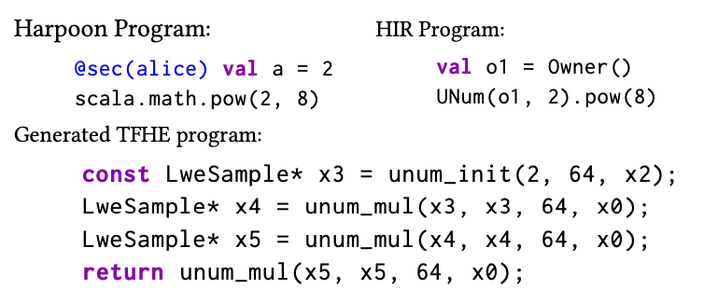
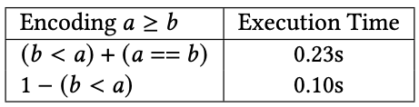
Optimizations
Scalar Multiplication
Private Comparison
Notes:
Now let us look at two optimization strategies to improve the performance of secure MPC applications
The multiplicative depth of circuits is the main practical limitation in performing computation over encrypted data.
In computations we can eliminate multiplications if one of the operand is plaintext and it has the value of 0 or 1.
In addition to that, by grouping computations we can reduce the multiplications and depth of the circuit.
For instance, lets compute the 8th power of an encrypted number. The code is show on the left represent this computation.
If we translate this naively, we may end up with 7 multiplications. But by grouping these computation we can accomplish with only 3 multiplications. The abstract circuits are shown on the right.
Next optimization strategy is being clever in comparing private values.
A particular private comparison can be encoded into set of operations based on what’s offered by the backend.
Some of them can be faster than others.
For instance, greater than or equal comparison can be either rewritten to less than operation and an equality check
or less than operation and subtraction. In this case later is faster.

Slide 14
Evaluation
Secure Auctions
Matrix-Vector Product
Merge Sort
Notes:
We have evaluated our approach for developing secure MPC applications with three case studies.
-Secure Auctions,
-Matrix Vector Product, and
-Merge Sort
We will investigate this case studies in detail next

Slide 15
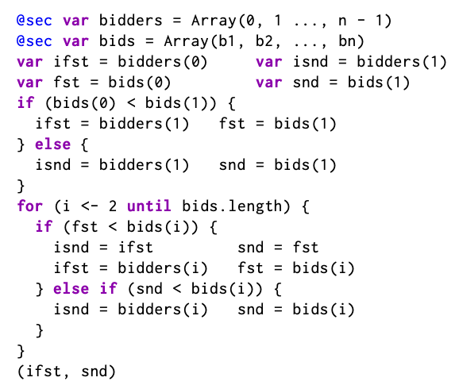
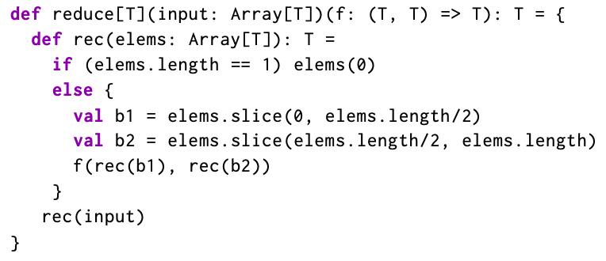
Secure Auction
Imperative Second-price Auction Code
Functional Auction Code
Backends
SPDZ and HoneyBadgerMPC
Notes:
Secure Auction is our motivating example.
On the left we have shown the imperative style implementation of second price auction.
Our compiler can transform this code into a simpler functional style one shown on the right -- bunch of reductions.
This yields a circuit of logarithmic depth that allows efficient parallel computation instead of one with a linear depth.

Slide 16
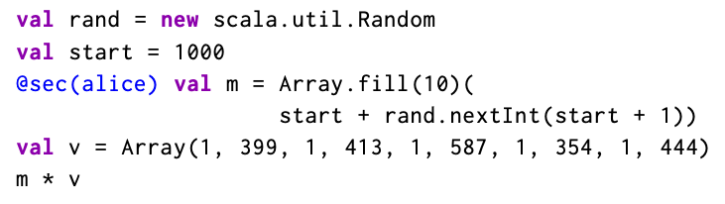
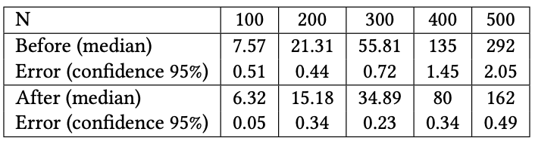
Matrix-Vector Product
I have the Matrix!!
I have the Vector!!
Client
Server
Application
SecureNN
Scalar Multiplication
Optimization !!
Backends
HElib and TFHE
Notes:
Our next case study is matrix-vector product.
Matrix-vector product is a core kernel in privacy preserving machine learning applications such as SecureNN.
In this setting one party owns the matrix and the other party owns the vector.
The harpoon code for matrix-vector product is shown on the left.
We have applied the scalar multiplication optimization that we saw earlier, for this case study.
We can clearly see the performance enhancement when we increase the matrix size

Slide 17
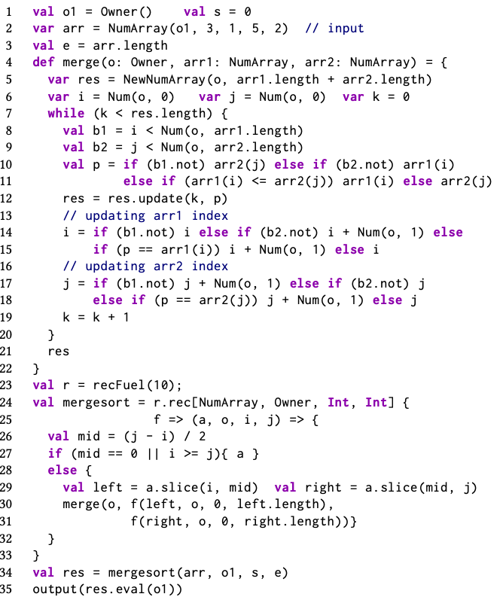
Merge Sort
Application
Secure Messaging
Backend
TFHE
Notes:
Our third case study is a merge sort implementation in HIR.
Secure sort is a core kernel in anonymous messaging applications.
This implementation requires the language features,
-array indexing
-conditionals
-recursion
Notably, an array lookup on a private index is not supported by most programming languages.

Slide 18
Conclusions
Secure MPC applications solve important practical problems
Developing performant Secure MPC applications requires variety of expertise (Crypto and Circuit Design).
HACCLE toolchain offers a compelling approach to the design and implementation of Secure MPC applications, using metaprogramming techniques.
Notes:
In conclusion,
secure mpc applications solve practically important problems.
developing secure mpc applications with reasonable performance requires expertise from variety of fields
In this work we have come up HACCLE toolchain, which offers a compelling approach to the design and implementation of secure mpc applications using meta programming techniques.

Slide 19
HACCLE: Metaprogramming for Secure Multi-Party Computation
Y Bao^{*+}, K Sundararajah*, R Malik, Q Ye, C Wagner, N Jaber,
F Wang, MH Ameri, D Lu, A Seto, B Delaware, R Samanta,
A Kate, C Garman, J Blocki, PD Letourneau, B Meister, J Springer,
T Rompf, and M Kulkarni
* Both authors contributed equally to this work.
⁺Work performed while author was at Purdue University.
Notes:
Thanks for listening my talk and I am happy to take any questions.

